Slide 1


Ollscoil Mhá Nuad
Maynooth University
Health and Safety Office
Health and Safety Information Clubs and Societies
Author: Daniel McDermott
Date: 09/10/2024

Slide 2

Introduction
Welcome to Maynooth University
Daniel McDermott Deirdre O’Sullivan
Contact: healthandsafety@mu.ie
Information: Health & Safety | Maynooth University
Ollscoil Mhá Nuad
Maynooth University
Health and Safety Office

Slide 3

Health and Safety
Clubs and Societies Responsibilities
Register and appoint a committee
Do not endanger yourself
Do not endanger others
Report unsafe conditions
Report accidents
Follow rules/procedures as required
Use equipment and tools safely
Wear Personal Protective Equipment as required
Complete training when required
Appoint a Safety Co-Ordinator if required
Plan trips and events
Ollscoil Mhá Nuad
Maynooth University
Health and Safety Office

Slide 4

Health and Safety on Campus
Accidents and First Aid
Report accidents / first aid to Clubs & Socs and inform H&S
Call medical centre 01 708 3878 or security on 01 708 3929
Call 999 or 112 if ambulance is required.
If on campus contact security and advise an ambulance has been requested
First aid kits available
18 Defibrillators located around campus
Existing Medical Conditions
Accident Reporting Clubs and Socs activities
  https://forms.office.com/e/XSnvnLn28t
Ollscoil Mhá Nuad
Maynooth University
Health and Safety Office

Slide 5
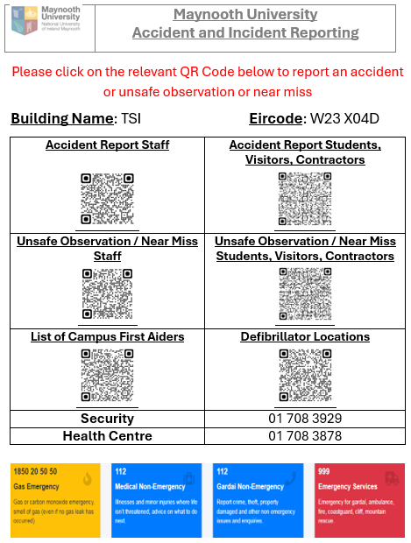
Health and Safety on Campus
Ollscoil Mhá Nuad
Maynooth University
Health and Safety Office

Slide 6

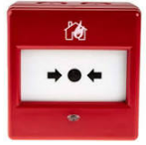


Health and Safety Fire
Fire
If you see a fire, press red BGU and
leave the building immediately
and go to nearest assembly point.
Follow the exit sign to leave building
On hearing fire alarm exit building immediately, do not delay!!!!
Re-enter only when instructed by security.
No smoking including e-cigarettes/vaping allowed in any building
Fire drills performed during academic year.
Ollscoil Mhá Nuad
Maynooth University
Health and Safety Office

Slide 7
Health and Safety
Safety Statement
Required to be completed annually
Outlines roles and responsibilities
Outlines emergency procedures
Identifies key personnel
Identifies training requirements and personnel trained
Identifies risks and control measures
MU Life Clubs & Societies
Ollscoil Mhá Nuad
Maynooth University
Health and Safety Office

Slide 8
Health and Safety
Clubs and Societies Risks
Access and Egress
Fire
Manual Handling
Electrocution
Food Safety
Overcrowding
Falls from height
Use of equipment
Interaction with personnel
Substance Abuse
Transport
Personal Injuries
Medical Risks
Weather
Vehicle interaction
Failure of equipment
Handling Money
Ollscoil Mhá Nuad
Maynooth University
Health and Safety Office

Slide 9
Health and Safety
Clubs and Societies Special Risks
Water Sports
  A minimum of 3 people required
  Life preservers to be worn
  Rescue plan to be discussed
Sports at height i.e. rock climbing
  Completed at specialised facilities
  Specialised facilities to supply equipment
  Insurance to be pre-submitted
Ollscoil Mhá Nuad
Maynooth University
Health and Safety Office

Slide 10
Health and Safety
Clubs and Societies Special Risks
Winter Sports
  Completed at specialised facilities
  Specialised facilities to supply equipment
  Insurance to be pre-submitted
Ollscoil Mhá Nuad
Maynooth University
Health and Safety Office

Slide 11
Health and Safety
Event Management
Permission required from Clubs & Socs office
Event management plan to be completed two weeks before the event
Rooms / Venues must be booked in advance
Building Fire safety rules to be followed
If holding an event off campus, fire safety declaration to be completed with premises
Insurance cover to be clarified with C&S office
Advise security if person of interest attending event
No home cooking. Approved food suppliers only.
Alcohol limitations to be adhered to
Ollscoil Mhá Nuad
Maynooth University
Health and Safety Office

Slide 12
Health and Safety
Event Management (cont)
Approved contractors. Safety documentation to be submitted prior to work commencing
Equipment to be inspected and tested
Competent and certified electricians only
Structures to be signed off and approved
MU premises to be protected against damage
Seek C&S office advice prior to signing contracts
MU and/or SPCM (South Campus) permission required to host events on campus
Additional professional first aid may be required i.e. intervarsities
Ollscoil Mhá Nuad
Maynooth University
Health and Safety Office

Slide 13
Health and Safety
Clubs and Societies Trips
Permission required from Clubs & Socs office. 21 days for foreign travel.
Risk assessment to be completed prior to event
MU Life to be updated with travel details and attendees
MU international travel contact details form to be completed on MU Life
Insurance coverage to be confirmed
Approved modes of transport to be used
Personal car use – not recommended
Disability access support to be discussed with C&S if required
Under 18’s not permitted on international travel
Ollscoil Mhá Nuad
Maynooth University
Health and Safety Office

Slide 14
Health and Safety
Clubs and Societies Equipment
Ensure all equipment is accounted for
All equipment to be inspected before use
If required, equipment to be certified for use
Ensure equipment provided/used for club events as per rules i.e. helmets worn playing hurling/camogie
Manual handling awareness
Where specialised facilities in use, copy of insurances to be pre-obtained and submitted
Ollscoil Mhá Nuad
Maynooth University
Health and Safety Office

Slide 15
Health and Safety
What do Clubs and Societies require?
Training? First Aid?
Facilities?
Support?
Remember: If you don’t ask you won’t receive!
Ollscoil Mhá Nuad
Maynooth University
Health and Safety Office

Slide 16
Health and Safety
Resources Available
Clubs and Societies Office
Health and Safety Office
Campus Services
MU Life
University website
Ollscoil Mhá Nuad
Maynooth University
Health and Safety Office

Slide 17

Health and Safety on Campus
Stay safe
and
enjoy your activities
in Maynooth University
Ollscoil Mhá Nuad
Maynooth University
Health and Safety Office

