Slide 1
First Day Contact Training

Slide 2
Session Outline
Why are you here?
Reason for initiative
First Day Contact Role
Boundaries of Role
Support Services in Maynooth
Scenarios

Slide 3
Who we are
Cian Brieffies (Assistant Psychologist)
Mia Dunne (Assistant Psychologist)
Kirsten McBrearty (Assistant Psychologist)
John Regan (Assistant Psychologist)
Áine Trayer (Assistant Psychologist)
Fred Walsh (Assistant Psychologist)

Slide 4
Who is MAP?
Maynooth Access Programme (MAP) supports under-represented groups in Maynooth University.
These include;
Students with Disabilities
Students who are economically and socially disadvantaged
Mature Students
QQI Entry students
Turn To Teaching (TTT) students

Slide 5
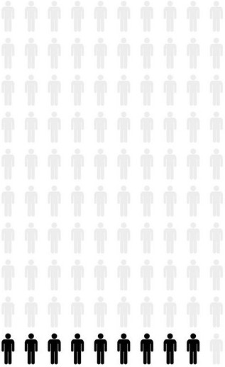
Students registered with the Disability Office in 2024
Students with disabilities accounted for 9% (1072 of 11824) of the total student population
27% of our students also disclosed additional conditions

Slide 6
Benefits of joining a club/society
Feeling part of a community
Meet new people
Enhanced experience of university
Try new interests

Slide 7
Difficulties Students face during this academic year
Financial difficulties
Concentration & Motivational difficulties
Increased stress
Mental Health Difficulties
Caring responsibilities

Slide 8
Reason for the FDC
To help with transitioning to University, settling in and making friends.
This initiative aims to create a bridge for students to take the initial step to joining clubs/socs.
Students that make social connections are more likely to complete their studies and have a more positive experience in college.
Maynooth has a very diverse student population

Slide 9
First Day Contact Role
What is it?
An initial connection point for MU students.
A Welcoming Person for students who are nervous/ unsure about joining clubs/socs throughout the year.
Introducing students to the group and ensuring they feel included.
A friendly and approachable person.
A person that signposts relevant supports/services.

Slide 10
What kinds of students will benefit from FDC?
Students who have previously completed a PLC/QQI course.
Students going through personal difficulties, e.g. bereavement, job loss, relationship breakups.
Mature students.
Students from socioeconomically disadvantaged areas.
Students with disabilities.
Neurodivergent students.

Slide 11
Neurodiversity refers to different neurotypes existing together
Individuals who are neurodivergent can differ from neurotypical individuals in the following ways:
Cognition
Sensory Processing
Behaviour

Slide 12
How do students engage with the FDC?
Go to the MULife Website and request interest in joining a club/society through the FDC
The students will be contacted about what club/soc they are interested in
The club/society will be made aware that the student wishes to join.
The FDC will phone/email the student, welcoming them to the club/society and answer any questions they may have.
The student will hopefully feel more at ease when attending the club/society.
The FDC can introduce the student to other members of the club/soc

Slide 13
Boundaries of Role
FDC is not expected to act as a counsellor/confidant
Main role is to make new students feel welcome in club/society, introduce them to others and facilitate conversation.
Not expected to be responsible for the person on an ongoing basis.
If concerned for student's safety contact campus security/Club & Socs Coordinators

Slide 14
Services to sign post
Academic Issues
Departmental office hours
Academic Writing centre
Personal Issues
Counselling Service
Chaplaincy
Other Issues
Student Budgeting Advisory
Student Services
Maths Support Centre
Academic Advisory Office
Student Health centre
24hr Text Support Text MU to 50808
MAP Office
Short-term loans
Student Help Desk

Slide 15
Scenario 1
A student reached out to the First Day Contact. They inform you that they are very apprehensive about going to a club/soc.
How would you respond?

Slide 16
Scenario 2
A student confides in you that they are having financial difficult and report that they are unsure if they can continue studying at Maynooth.
How would you respond?

Slide 17
Scenario 3
Student discloses that they are struggling with their mental health since beginning college. They are away from home, feel isolated and report not having any social support in MU.
How do you respond?

Slide 18
How to deal with students in distress
Reassure them that they are engaging in a club/soc which is a great way to meet people and develop friendships in college.
Sign post student to relevant services to support their mental health:
Are you aware there is a Counselling Service available to students?
Student Health Centre
Chaplaincy
24 hour Text Support
If concerned for student’s safety and club/soc out of hours- contact Campus Security on 01 708 3929
Contact clubs/soc officer in case of any issues- Mary McCourt/Mary Banahan
Call emergency services

Slide 19
Overview
The FDC is a welcoming role for students that are apprehensive about joining a club/soc.
The FDC can call/email the student prior to a club/soc to help reduce their nerves.
The FDC initiative is aimed to help engagement, allow students to be part of the college community and meet new people.

Slide 20
Any Questions?

