Slide 1
MU Life
How to submit your Budget

Slide 2
Capitation
This is the name given to the Money that the University give to Clubs and Societies to run for the year.
The name comes from “Per Capita” meaning per head. When you pay your Student Fees at the start of the year the University take a percentage of those fees and give this money to Clubs and Societies to run for the year.
Capitation money is Student Money and is also Public Money and must be accounted for.
Capitation will never fully fund the running of your C/S, you are expected to raise 50% of what it takes to run your C/S.
This year the University gave Clubs and Societies €311,747 in Core Capitation and €171,098 in Coaching. All of this money must be accounted for at the end of this Academic Year.
Any Capitation that is not drawn down on MULife will be lost by the C/S, if you don’t use it, you will lose it. This money will go back into the Pot for next year’s budget run.
This Photo by Unknown Author is licensed under CC BY-NC

Slide 3
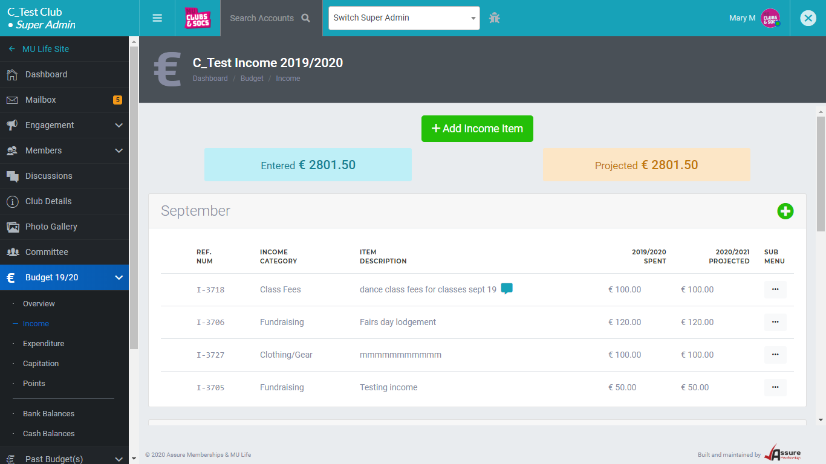
Upload all income
All Income collected should be recorded :
Membership
Hoodies/gear
Transport
Accommodation
Any money collected from your members
Sponsorship
Fundraising

Slide 4
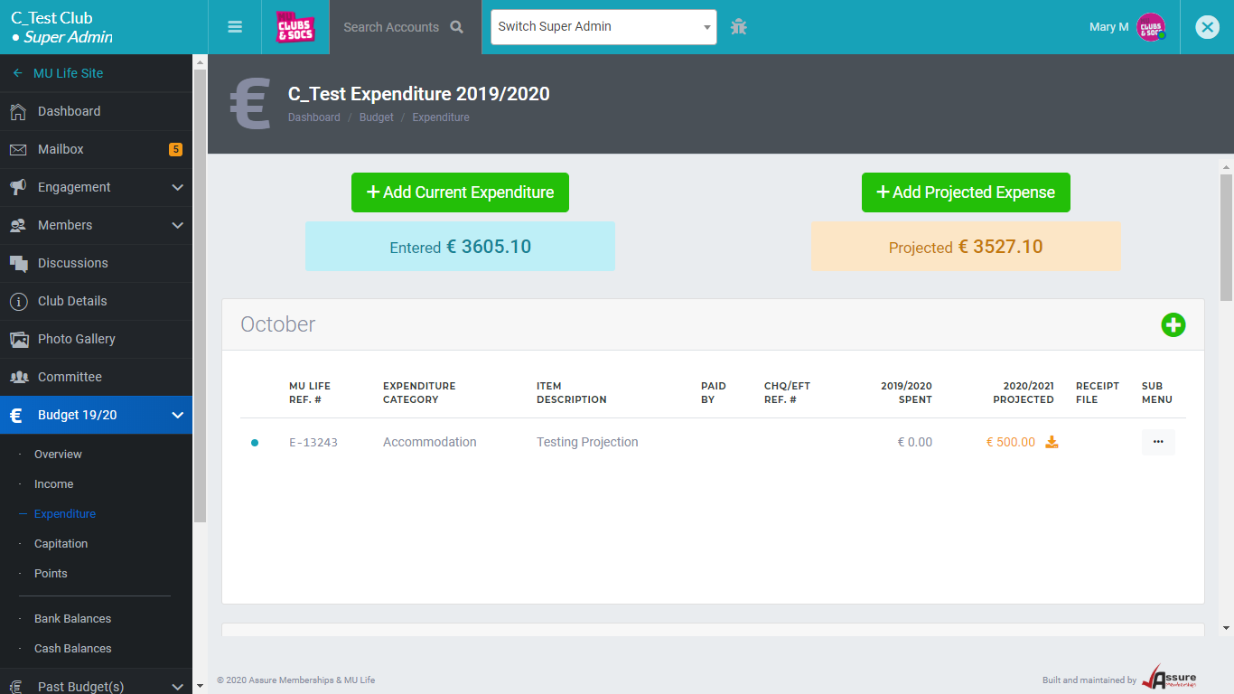
Upload All Expenditure
All Expenditure should be accounted for and backed up with correct paperwork – Invoice/Receipt.
Rejected expenditure will not be projected for next year’s budget
Expenditure items with no paperwork will not be projected for next year’s budget
Invoices should be addressed to the club or society not to committee members.
The invoice/receipt amount should match the amount entered on MU Life
When paying by cheque, please insert cheque numbers.
Use your bank statements as a guide to ensure you have uploaded all expenditure
If your C/S hold cash, please update your cash box on MULife

Slide 5
projections
Once you have all your current income and expenditure recorded you are now in a position to project what you need for next year.
Your approved current expenditure will automatically project. This can be increased and backed up with a quote.
You can also add new projections for something that did not take place this year but you will be hosting/attending next year.
New equipment/gear can also be projected.

Slide 6
Budget overview Are you on track?
At the top of your Budget Overview you will see a percentage ratio. It will either be Red, Yellow or Green. These ratios are a good guide when completing your budget to gauge if you are going to receive what you asked for.
Amount applied for is the difference between income and expenditure plus points.
Note you should have raised at least 50% of your income in the past academic year. Please record all monies collected.
There are 3 Projected Income/Expenditure Ratios:
Red
Yellow
Green

Slide 7
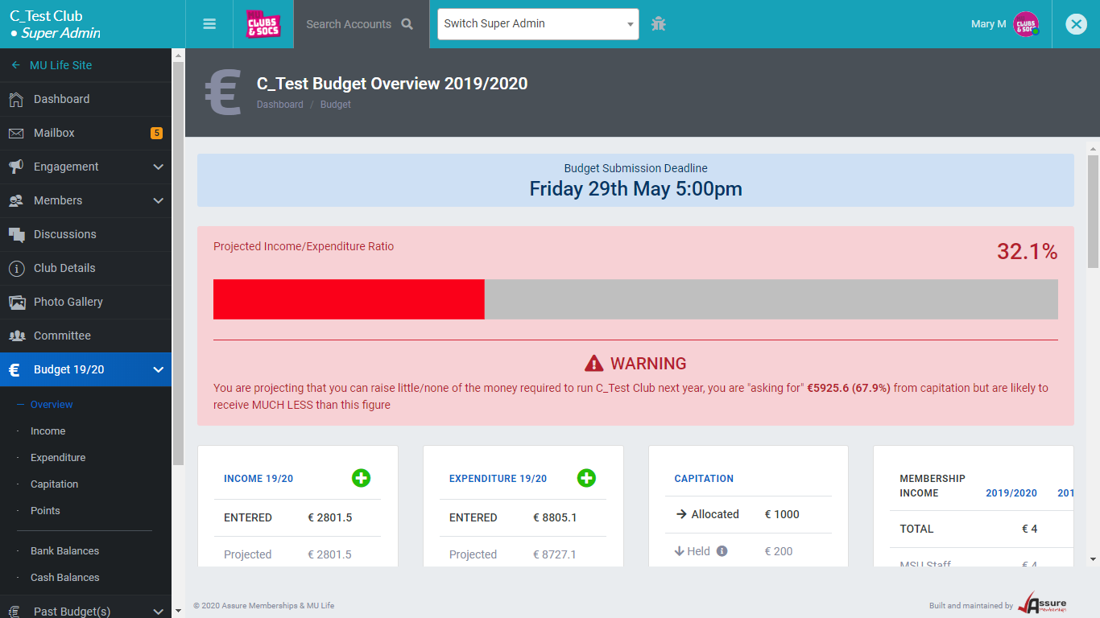
You are projecting that you can raise little/none of the money required to run your Club/society next year, you are "asking for" (100%) from capitation but are likely to receive MUCH LESS than this figure

Slide 8
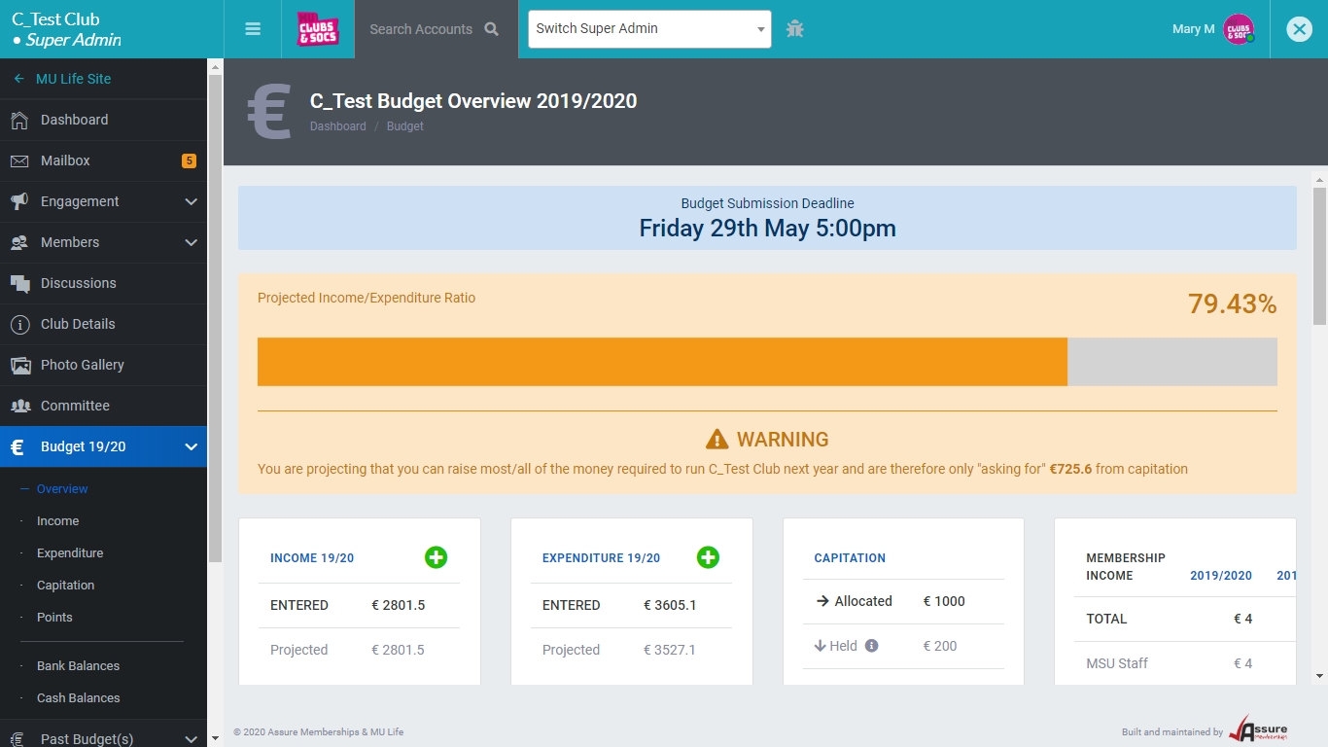
You are projecting that you can raise most/all of the money required to run your Club/Society next year will need very little capitation

Slide 9
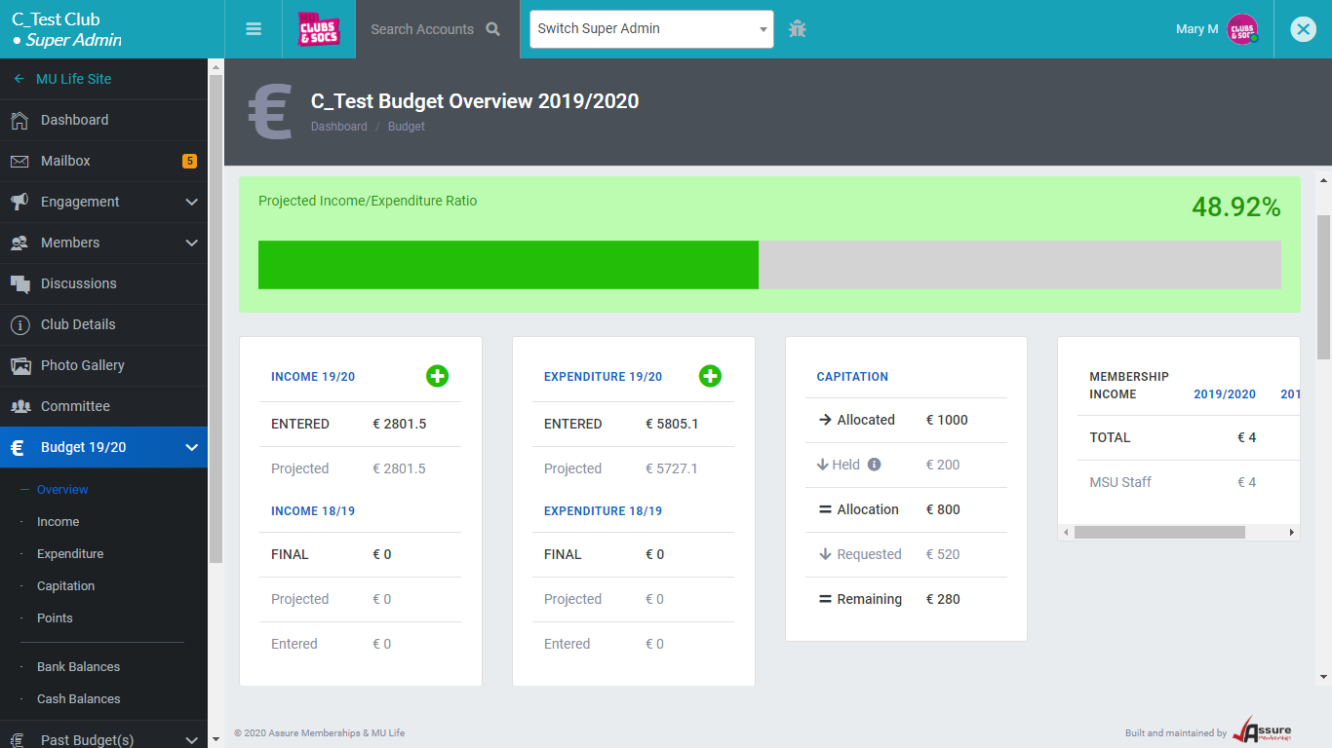
Almost guaranteed to receive funding requested
Note
What have you requested?
If the difference between your income and expenditure is €100 that is what you are likely to get, once you have completed your points section.
Green is a good percentage ratio but make sure you are requesting enough.

Slide 10
Points – points – points
The second part of the budget submission is the points section.
Points are just as important as the budget section. This is how you get to the top of the pecking order. The more points the more likely you are to get what you have asked for. Over 70 points.
Some points are automatically awarded eg attending Fairs Day.
Others you will need to give us the information eg. Committee Development.

Slide 11
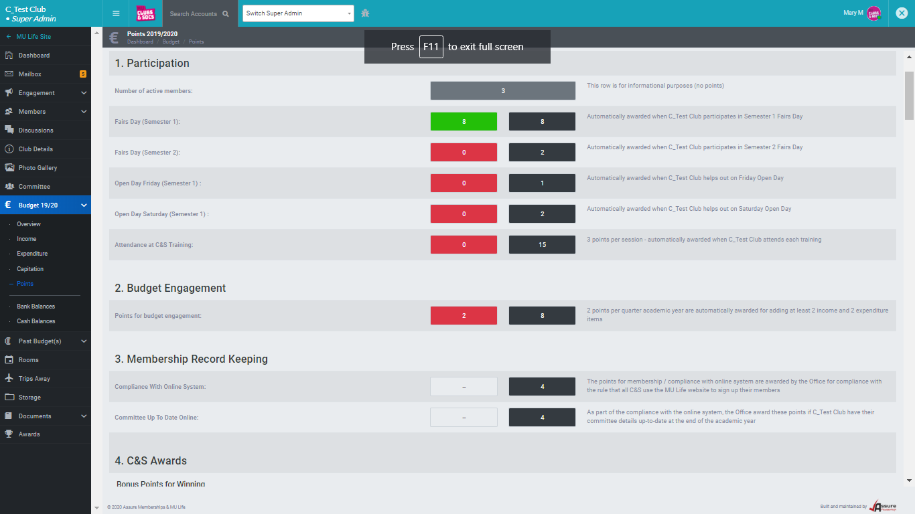
Points automatically awarded
Points are awarded automatically for the following:
Attending training,
Fairs Day, Open Days
Recording income/expenditure each quarter.
Clubs/Societies Awards – nominations/winners
Handover documents
Complying with C & S guidelines/MU Life

Slide 12
Points that need supporting documentation
Some sections require supporting information/documentation.
Handover documents for each committee position – at least 4 documents.
Committee minutes – at least 3 meetings.
Publicity – use of the News/Events page on MU Life.
There is the facility to upload posters, documentation for events, guest speakers, number of teams/grades etc. via the blue file box at each point section.

Slide 13
Checklist
The checklist will turn green when everything has been ticked. You will then be in a position to sign off.
You cannot submit your budget until you have ticked off everything on the checklist.

Slide 14
Sign off
The checklist has turned Green, and you are now ready to submit your Budget for 2023.
This will require 1 core committee member to tick that they agree with the budget submission. Ensure all committee agree with submission.
Ensure all core committee members have access to the budget page.
Note: An ordinary committee member cannot sign off on the budget.
Click the blue submit budget button.
Budget submission deadline – Friday 2nd June, 2pm

